Slide 1

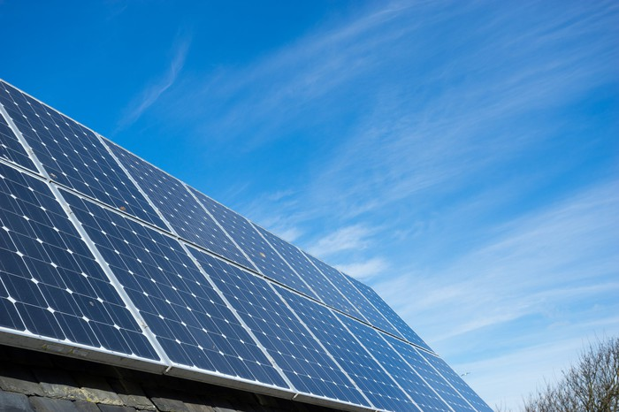
FUTURISTIC
TRENDS OF
SOLAR ENERGY
Team Members
Rakshith M S
Rakshith V Patil
Rakshitha Patel
Raunak Singh
Rishab.S

Slide 2
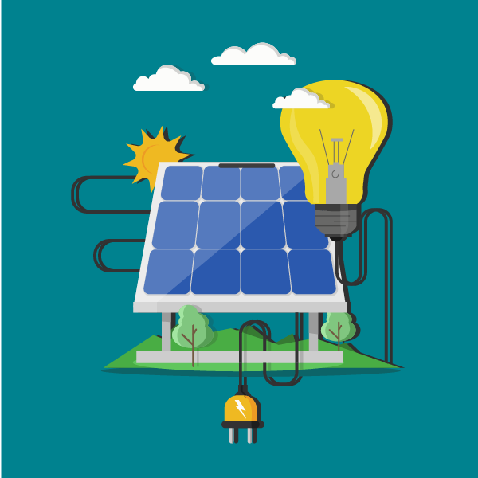
What is solar energy?
The basic concept of solar energy is to utilize the sun’s energy to generate electricity.
Solar power generates electricity with -
no global warming pollution
no fuel costs
no risks of fuel price spikes
The sun’s energy can be converted into electricity through solar photovoltaic (PV) modules (photo = light, voltaic = electricity) or solar panels.

Slide 3
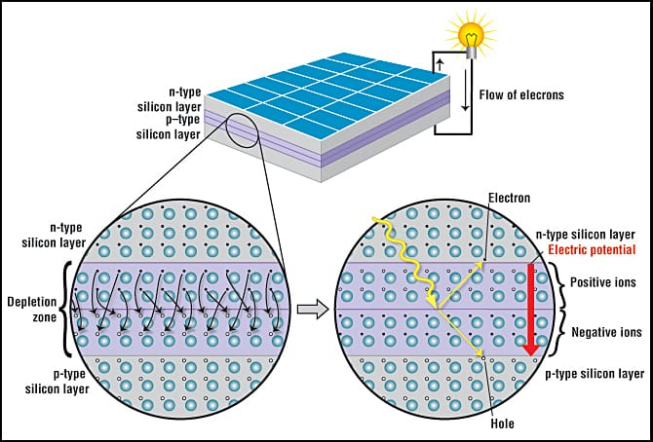
How exactly does a solar cell
work?
The PV cell consists of one or two layers of a semi conducting material, usually silicon. When light shines on the cell it creates an electric field across the layers causing electricity to flow. The greater the intensity of the light, the greater the flow of electricity.

Slide 4
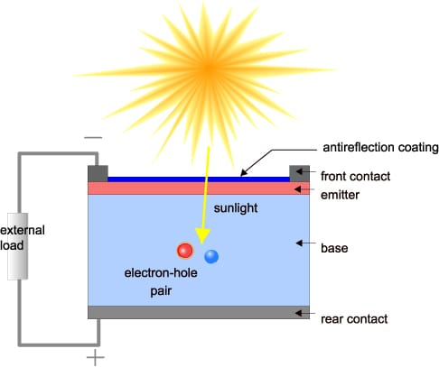
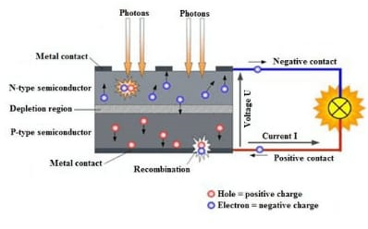
n-type and p-type semiconductors are put next to each other to form a PN-junction. When a free electron from the n-type half makes it to the p-type half, it fills a hole in the depletion region. When light hits the depletion region, it can cause electrons to leave the holes they filled. The p-type and n-type sides are connected with an external wire or circuit, which acts as a ‘backdoor’ for electrons.
Electrons moving through a wire? That’s current! And that’s how we get electricity using Solar PV

Slide 5
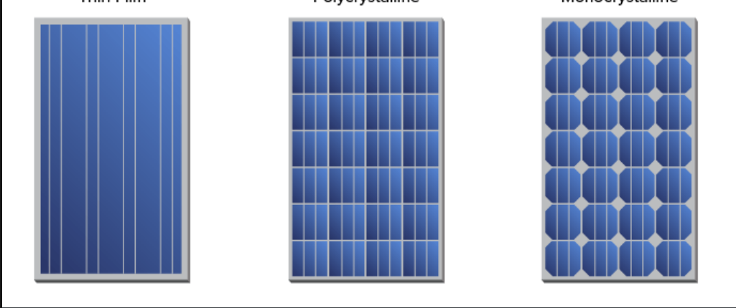

Different types of solar panels
Monocrystalline
Polycrystalline
Thin-film
* Crystalline solar panels have the highest efficiency.

Slide 6
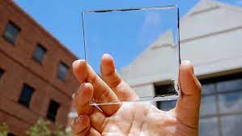
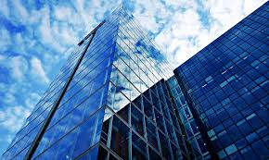
Transparent Solar Panels
Imagine a world where we could generate electricity using the surface of our windows, smartphones, our car's sun roof or the glass roof of our office building. What sounds like a far-away dream, is on its way to become reality thanks to transparent solar panels.

Slide 7
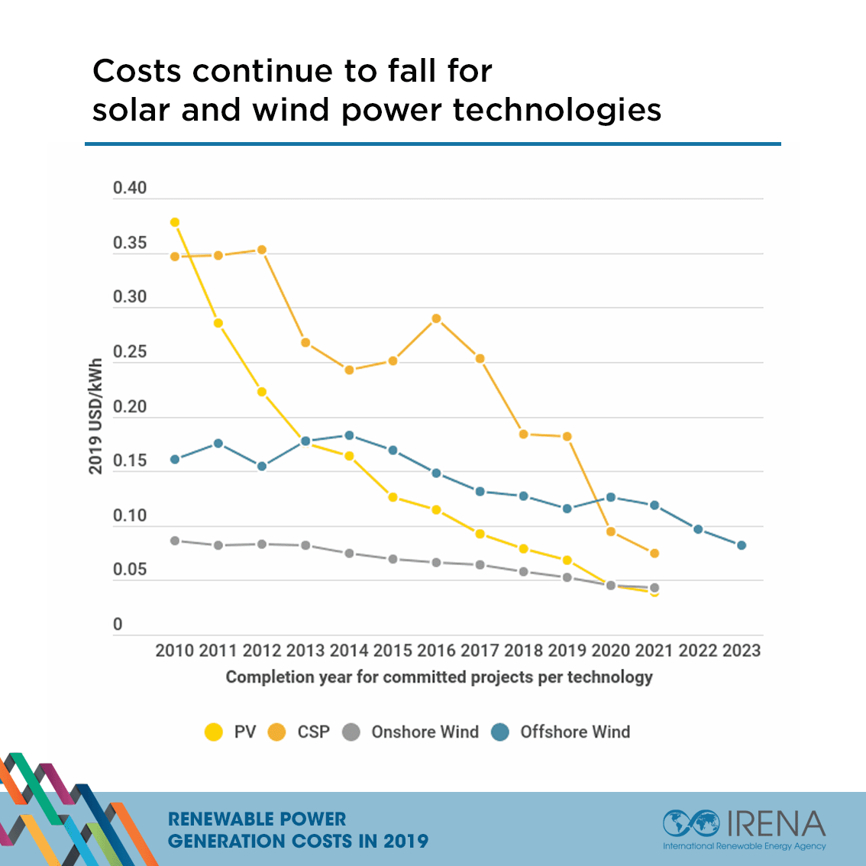
What makes Solar energy special?
Solar power is increasingly affordable
It is a renewable Energy Source
It reduces Electricity Bills
It has diverse applications
Low Maintenance Costs
Leading technology development
Improving grid security
pollution-free and causes no greenhouse gases to be emitted after installation

Slide 8
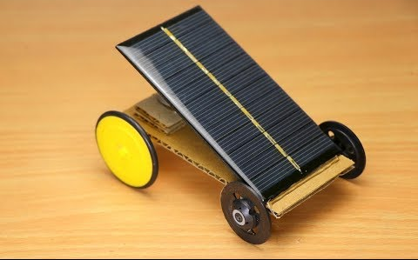
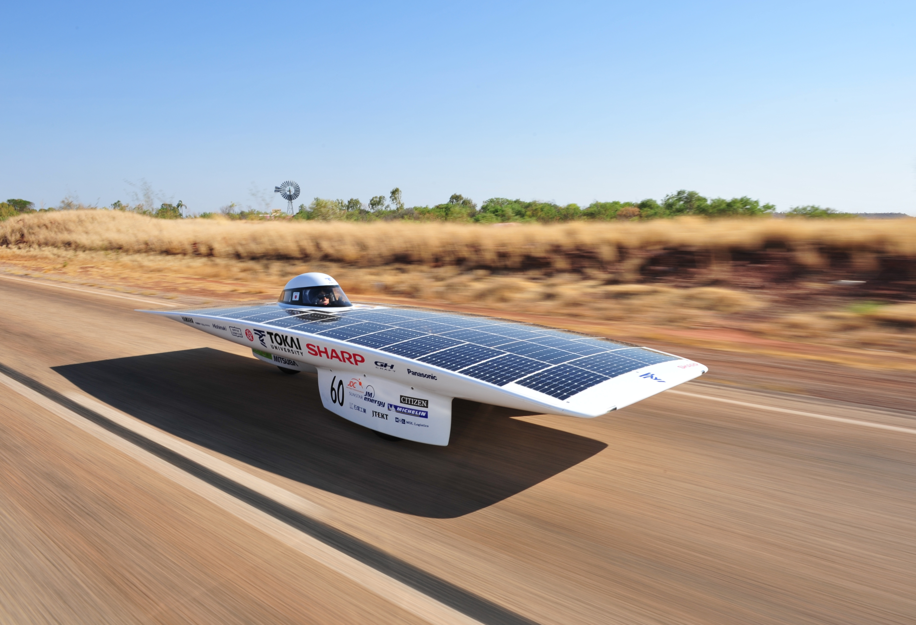
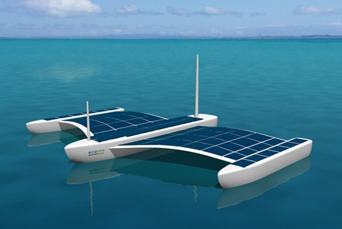
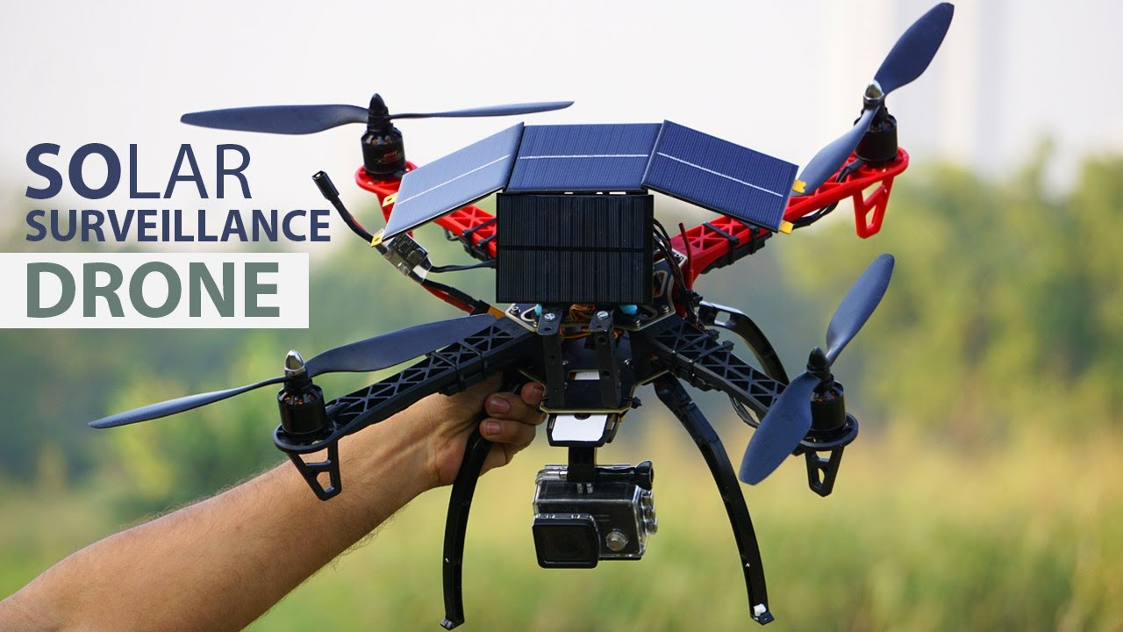
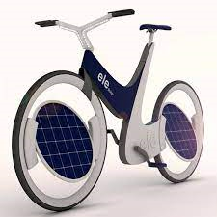
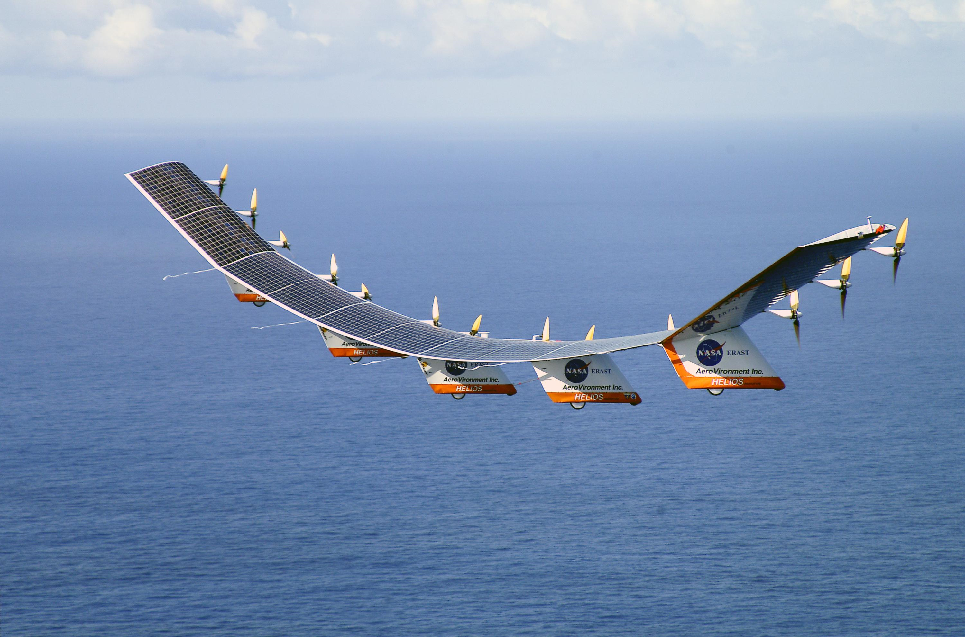
A Solar World !!!
Solar energy has vast applications, with the development in technology solar power is also expanding its arms in various sectors such as automobiles, drones, household electricity needs, etc.

Slide 9
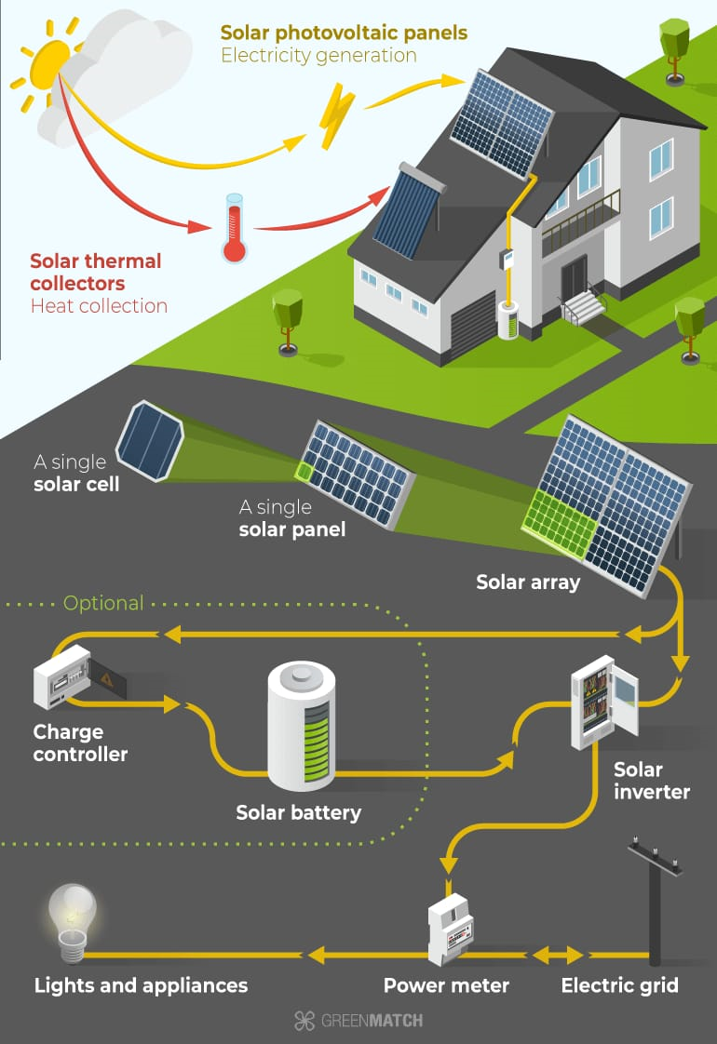
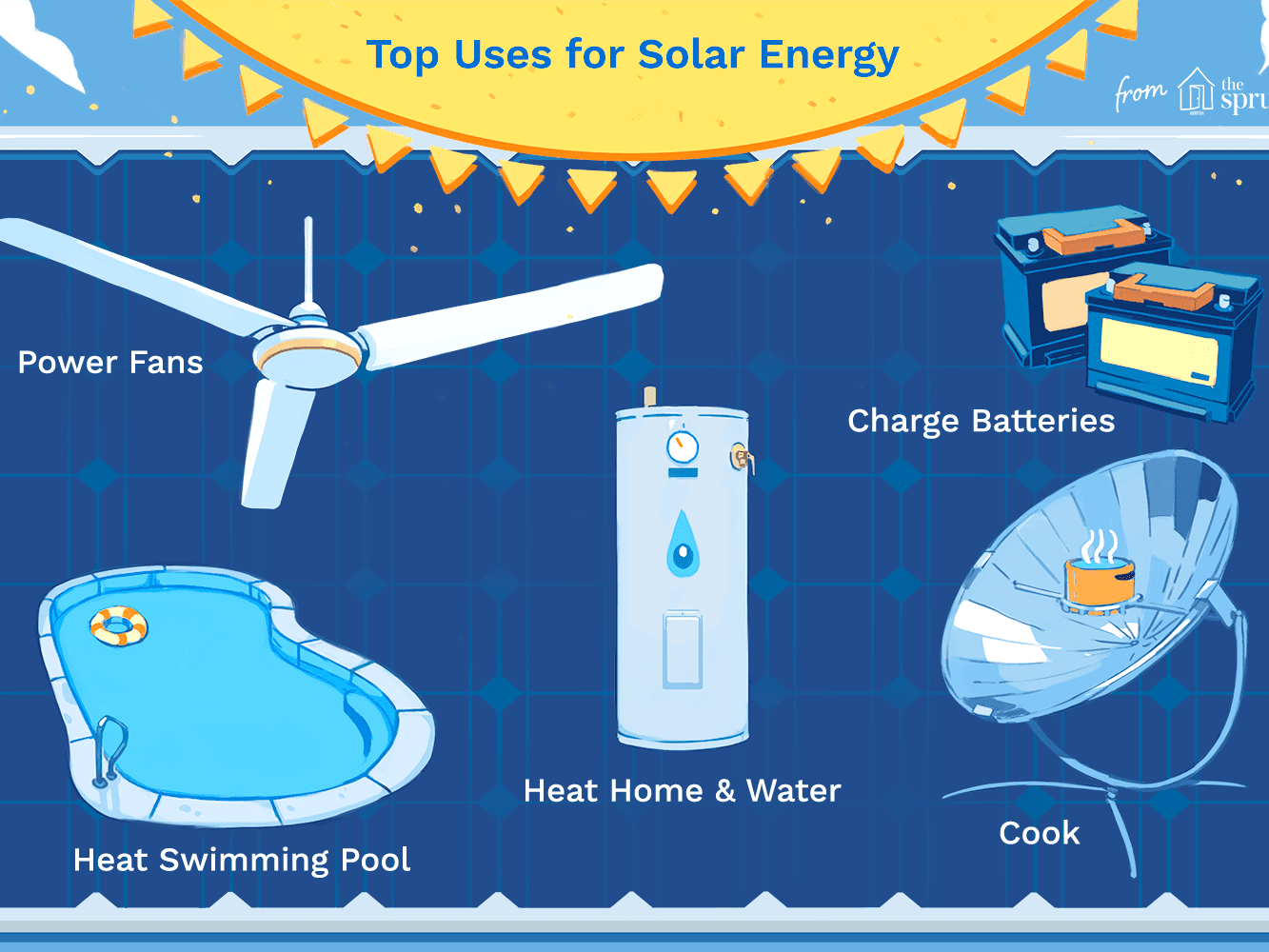
Household applications include-
Overall electricity generation
Water heaters
Ventilation fans
Powered pumps

Slide 10
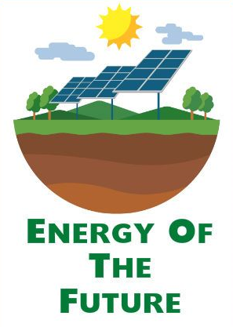
A Sunny Future!!
Solar energy is on the path to becoming a dominant energy source in the near future because of environment and economic friendliness. It satisfies the sustainable, reliable, and modern needs of the world while working hand in hand with the ecosystem to make the future a better place.

Slide 11
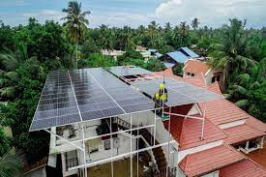
India's 40 GW solar rooftop target for 2022: A Kerala case study
Kerala has anywhere between 130 and 140 megawatt (MW) of solar photovoltaic (PV) installations, which includes big ticket projects like the Solar Energy Corporation of India (SECI)-owned 50 MW and Cochin airport’s 40 MW.But the relatively small state of Kerala is quickly running out of land, especially to accommodate the space-intensive solar technology. Installing a solar PV to generate a single kilowatt (kW) requires 10 square metres of land.Upcoming large-scale projects are instead looking at floating, dam-top and canal-top installations, in an attempt to utilise all available space.

Slide 12
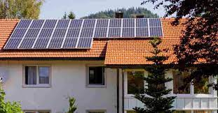
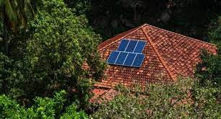
Continued..
An easier alternative for the land-constrained state would be to install smaller solar rooftop (SRT) systems. However, the SRT segment, as in the rest of India, has seen little progress.“Today, there is approximately 40 MW of SRT and possibly another 20-30 MW that is not accounted for,” Aneesh Prasad, programme officer at Agency for Non-Conventional Energy and Rural Technology (Anert), said.Anert’s dedicated programmes played a crucial role in the initial proliferation of SRT in the state. A case-in-point is the first ever ‘10,000 rooftop programme’ by Anert.

Slide 13
DRAWBACKS
Expensive : solar panel installation and also maintainance cost is high.
Delicate to handle : need skilled labour during installation and repair work.
Depends on visibility of sun.

Slide 14
References:
Strunk Jr., W., White, E.B., 1979. The Elements of Style, third ed. Macmillan, New York.
https://www.elsevier.com/journals/solar-energy
https://www.downtoearth.org.in/blog/energy/india-s-40-gw-solar-rooftop-target-for-2022-a-kerala-case-study-69261
Engineering chemistry ,by Mahesh .B & Roopashree B.

Slide 15
Thank You!!

